Slide 1


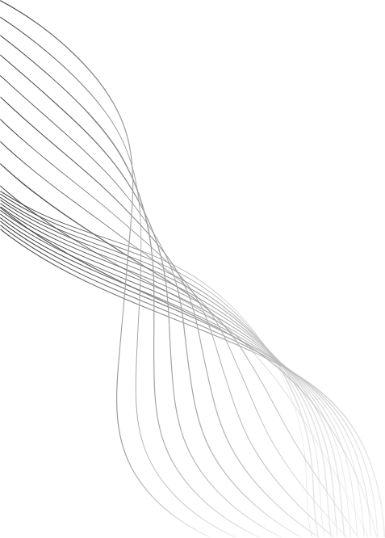
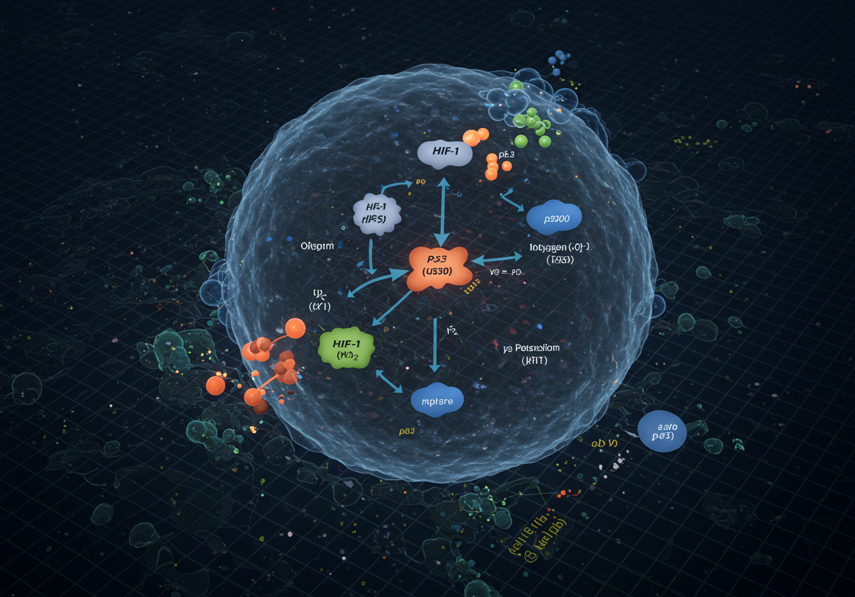

APOPTOSIS
programmed cell death

Slide 2

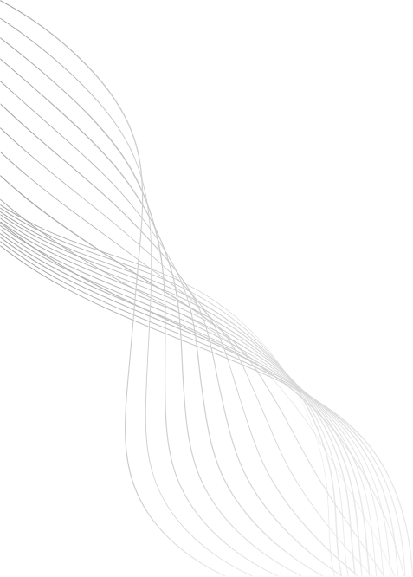
ABOUT APOPTOSIS
Apoptosis is programmed cell death — a self-destruction system for damaged or unwanted cells.
This process is controlled, clean, and necessary for growth, defense, and maintaining balance.
It plays a crucial role in preventing tumors, infections, and autoimmune damage.
"Apoptosis is like a biological delete button — it removes harmful cells without damaging surrounding tissue."
02

Slide 3




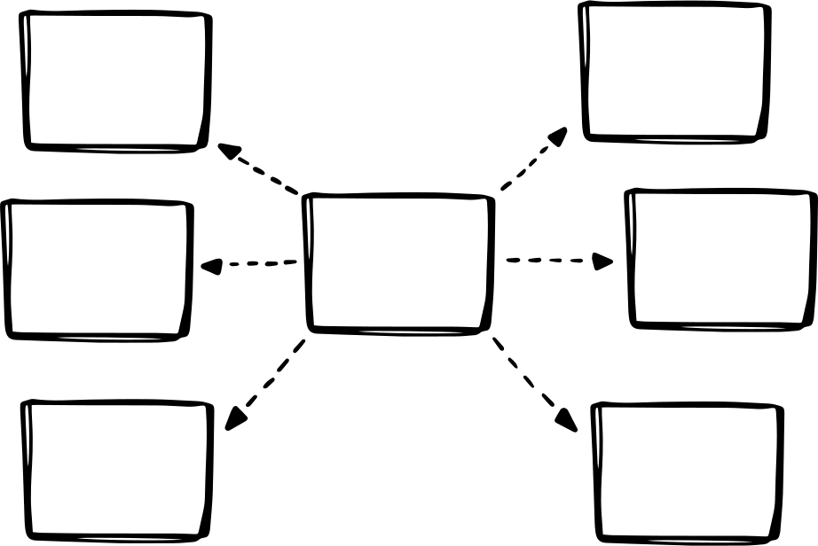


Flowchart
A key protein that triggers apoptosis when damage is detected.
A protein that is activated when oxygen is low
y_p53
y_hif
A family of enzymes that break down the cell during apoptosis.
y_o2
y
y_casp
The level of oxygen available in the cell.
y_p300
y_kp
The level of potassium inside the cell.
A transcription coactivator that works with HIF and P53.
03

Slide 4
ODE Model of Apoptosis
What is it?
We use a system of Ordinary Differential Equations (ODEs) to describe how key molecules change over time during apoptosis.
Each equation shows:
How the concentration of each variable (y) increases or decreases
Based on biological interactions
# Define parameters
params = {
'ahif': 1.52, 'ao2': 1.8, 'ap53': 0.05, 'a3': 0.9, 'a4': 0.2,
'a5': 0.001, 'a7': 0.7, 'a8': 0.06, 'a9': 0.1, 'a10': 0.7,
'a11': 0.2, 'a12': 0.1, 'a13': 0.1, 'a14': 0.05 }
# System of ODEs
def apoptosis_ode_system(t, y, p):
"""Defines the system of ODEs for apoptosis."""
yhif, yo2, yp300, yp53, ycasp, ykp = y
dyhif_dt = p['ahif'] - p['a3']*yo2*yhif - p['a4']*yhif*yp300 - p['a7']*yp53*yhif
dyo2_dt = p['ao2'] - p['a3']*yo2*yhif + p['a4']*yhif*yp300 - p['a11']*yo2
dyp300_dt = p['a8'] - p['a4']*yhif*yp300 - p['a5']*yp300*yp53
dyp53_dt = p['ap53'] - p['a5']*yp300*yp53 - p['a9']*yp53
dycasp_dt = p['a12'] + p['a9']*yp53 - p['a13']*ycasp
dykp_dt = -p['a10']*ycasp*ykp + p['a11']*yo2 - p['a14']*ykp
return np.array([dyhif_dt, dyo2_dt, dyp300_dt, dyp53_dt, dycasp_dt, dykp_dt])
04

Slide 5






PROJECT GOALS
Simulate apoptosis modeling
Compare numerical solvers
Apply PINNs
Visualize molecular dynamics
Bridge biology and engineering
Investigate applications
Use ODEs to capture how HIF, P53, caspases and other factors evolve over time under low oxygen.
Implement physics‑informed neural networks as an alternative method for solving the ODE system.
Translate a complex cellular process into a mathematical framework for biomedical insights.
Evaluate Euler, RK4 and RKF45 in terms of accuracy, stability and computational cost.
Plot time courses of key concentrations to reveal trigger points and response patterns.
Relate our findings to cancer therapy, drug screening and tissue engineering scenarios.
05

Slide 6
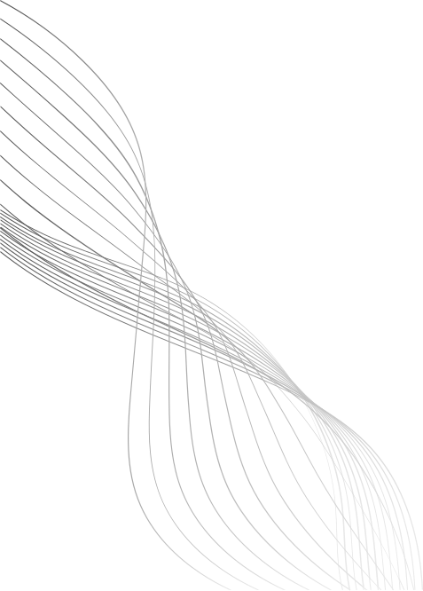
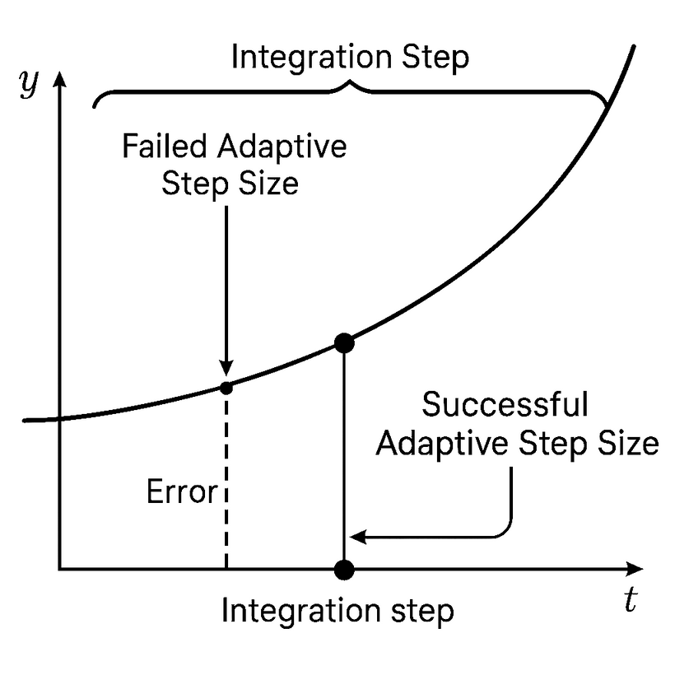
RKF45
What is RKF45
Runge-Kutta-Fehlberg (RKF45)
Combines 4th and 5th order methods
Provides adaptive step-size control
Used to solve ODEs efficiently with local error estimation
06

Slide 7
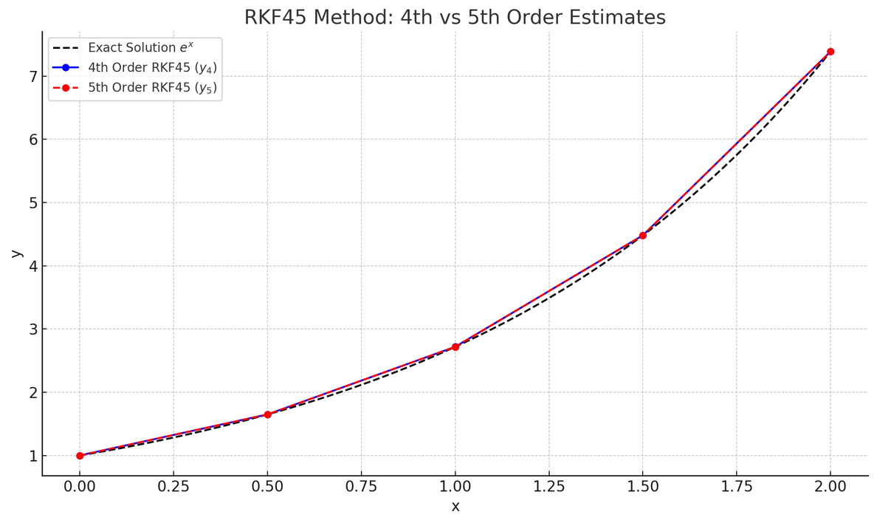
How RKF45 Works
At each step:
Calculate six intermediate slopes (k₁ to k₆).
Compute two solution estimates:
4th order: y(4)
5th order: y(5)
Estimate local error:
e=∣y(5)−y(4)∣
Compare error to tolerance:
If e>tolerance, reduce step size and recalculate.
If e≤tolerance, accept step and possibly increase step size.
Repeat until the solution reaches the final time.
07

Slide 8
Solving Apoptosis ODEs Using RKF45 in Python
RKF45 INTEGRATOR LOOP (CORE IDEA)
def rkf45_with_error(f, t0, y0, t_end, h0=0.1, tol=1e-6):
while t < t_end:
if t + h > t_end:
h = t_end - t
# coefficients for Fehlberg RKF45
c = np.array([0, 1/4, 3/8, 12/13, 1, 1/2])
a2 = np.array([1/4])
a3 = np.array([3/32, 9/32])
a4 = np.array([1932/2197, -7200/2197, 7296/2197])
a5 = np.array([439/216, -8, 3680/513, -845/4104])
a6 = np.array([-8/27, 2, -3544/2565, 1859/4104, -11/40])
b4 = np.array([25/216, 0, 1408/2565, 2197/4104, -1/5, 0])
b5 = np.array([16/135, 0, 6656/12825, 28561/56430, -9/50, 2/55])
k1 = f(t + c[0]*h, y) * h
k2 = f(t + c[1]*h, y + a2[0]*k1) * h
k3 = f(t + c[2]*h, y + a3[0]*k1 + a3[1]*k2) * h
k4 = f(t + c[3]*h, y + a4[0]*k1 + a4[1]*k2 + a4[2]*k3) * h
k5 = f(t + c[4]*h, y + a5[0]*k1 + a5[1]*k2 + a5[2]*k3 + a5[3]*k4) * h
k6 = f(t + c[5]*h, y + a6[0]*k1 + a6[1]*k2 + a6[2]*k3 + a6[3]*k4 + a6[4]*k5) * h
y4 = y + b4[0]*k1 + b4[1]*k2 + b4[2]*k3 + b4[3]*k4 + b4[4]*k5
y5 = y + b5[0]*k1 + b5[1]*k2 + b5[2]*k3 + b5[3]*k4 + b5[4]*k5 + b5[5]*k6
ee = y5 - y4 # Truncation error estimate at this step
err = np.linalg.norm(ee, ord=np.inf)
if err <= tol:
t += h
y = y4
ts.append(t)
ys.append(y.copy())
ees.append(ee.copy())
# adapt step size
delta = 0.84 * (tol / (err + 1e-16))**0.25
h = max(min(delta * h, 5*h), 0.1*h)
MODEL: 6 ODES SIMULATE KEY PROTEINS IN APOPTOSIS (HIF-1, O₂, P300, P53, CASPASE, K⁺)
METHOD: HAND-CODED RKF45 (RUNGE-KUTTA-FEHLBERG) WITH ADAPTIVE STEP SIZE AND ERROR CONTROL
SIMULATION: COMPARED TWO INITIAL CONDITIONS:
CASE 1: HIF-1 ACTIVE → Y₀ = [1, 0, 0, 0, 0, 0]
CASE 2: ALL INACTIVE → Y₀ = [0, 0, 0, 0, 0, 0]
OUTPUT:
TRACKED CONCENTRATIONS OVER TIME
EVALUATED TRUNCATION ERROR (Y₅ − Y₄)
HIGHLIGHTED SENSITIVITY TO INITIAL CONDITIONS VIA PLOTS
08

Slide 9
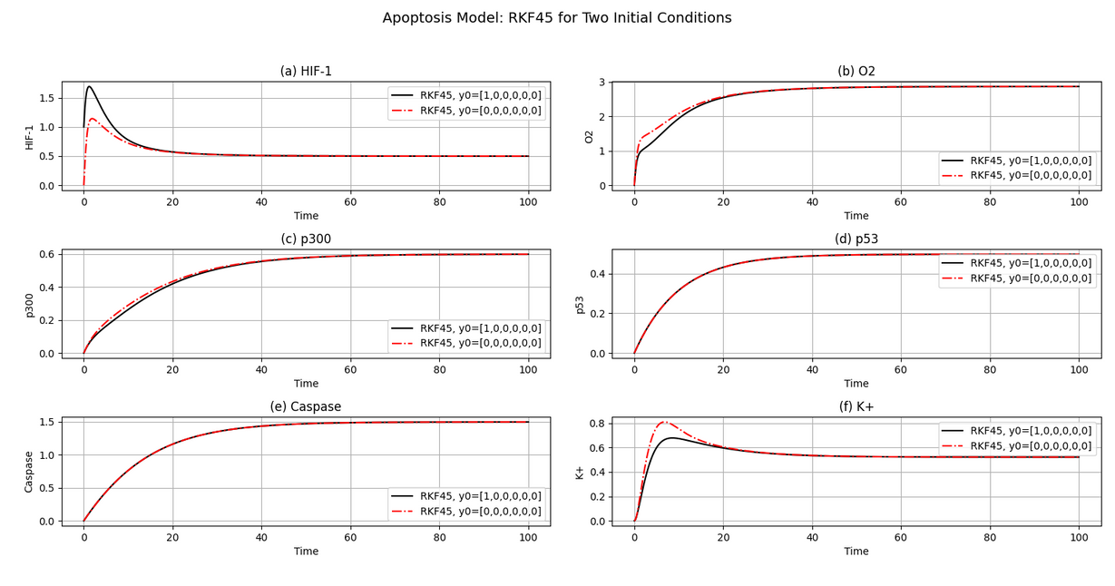
RESULTS - PLOTS
Simulation of six apoptosis-related components using RKF45.
Black line: Initial condition y₀ = [1, 0, 0,0,0 0] resent at start
Red dashed line: Initial condition y₀ = [0,0,0,0 0,] components start at zero
Limitations:
Can be slower on very stiff systems.
Requires more computations per step than simple methods.
Complexity in implementation compared to fixed-step solvers.
09

Slide 10
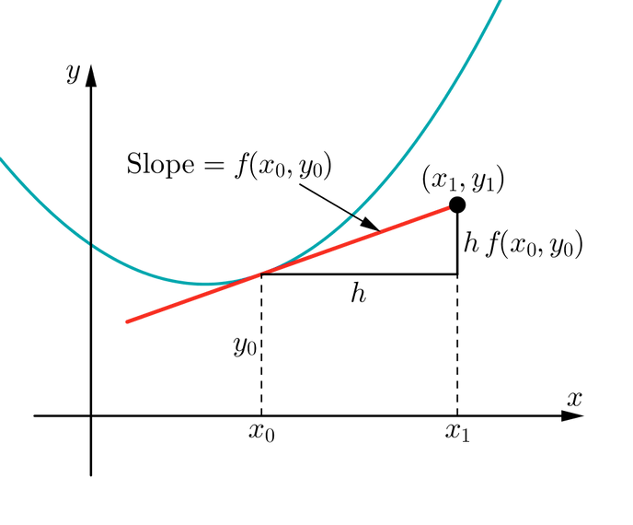
EULER
What is Euler’s method?
_
dy
yn+1 = yn + h
dx
A first-order numerical procedure for solving ordinary differential equations (ODEs).
Approximates the solution by stepping forward in small increments using the derivative (slope) at the current point.
10

Slide 11
Solving Apoptosis ODEs Using Euler Method in Python:
SIMULATION: COMPARED TWO INITIAL CONDITIONS:
CASE 1: HIF-1 ACTIVE → Y₀ = [1, 0, 0, 0, 0, 0]
CASE 2: ALL INACTIVE → Y₀ = [0, 0, 0, 0, 0, 0]
OUTPUT:
TRACKED PROTEIN CONCENTRATIONS OVER TIME
DEMONSTRATED SENSITIVITY TO INITIAL CONDITIONS THROUGH PLOTTED TRAJECTORIES
COMPARED STABILITY AND ACCURACY LIMITATIONS
LIMITATIONS OF EULER METHOD:
LOW ACCURACY: FIRST-ORDER, ACCUMULATES SIGNIFICANT ERROR
FIXED STEP SIZE: CAN MISS RAPID BIOLOGICAL CHANGES
COMPUTATIONALLY INEFFICIENT: NEEDS VERY SMALL STEPS FOR PRECISION
NO ERROR CONTROL: LACKS ADAPTIVE CORRECTION
# Euler method solver
def euler_solver(ode_func, y0, t_span, dt, p):
"""An implementation of the Explicit Euler method."""
t_start, t_end = t_span
t_vals = np.arange(t_start, t_end + dt, dt)
y_vals = np.zeros((len(t_vals), len(y0)))
y_vals[0, :] = y0
for i in range(len(t_vals) - 1):
y_current = y_vals[i, :]
slope = ode_func(t_vals[i], y_current, p)
y_vals[i+1, :] = y_current + dt * slope
return t_vals, y_vals
11

Slide 12
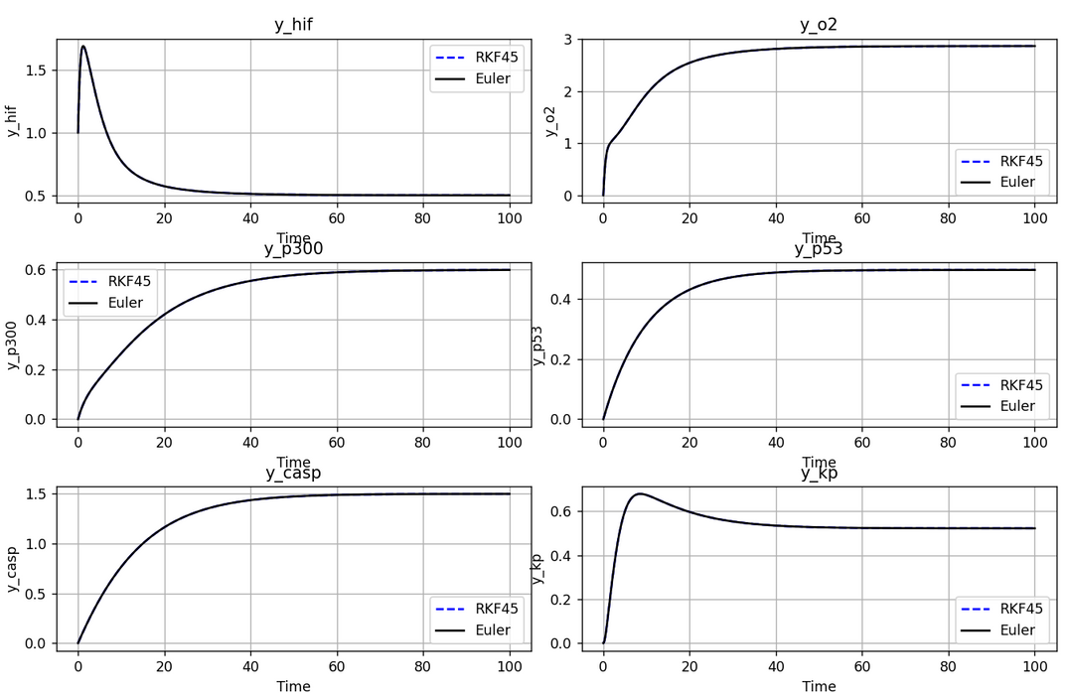
EULER VS RKF45
Error: Euler builds up error quickly (Global: O(h)), while RKF45 maintains high accuracy with adaptive steps (Global: O(h⁴)).
Stability: Euler can become unstable for stiff equations, while RKF45 remains robust and reliable across varying step sizes.
12

Slide 13
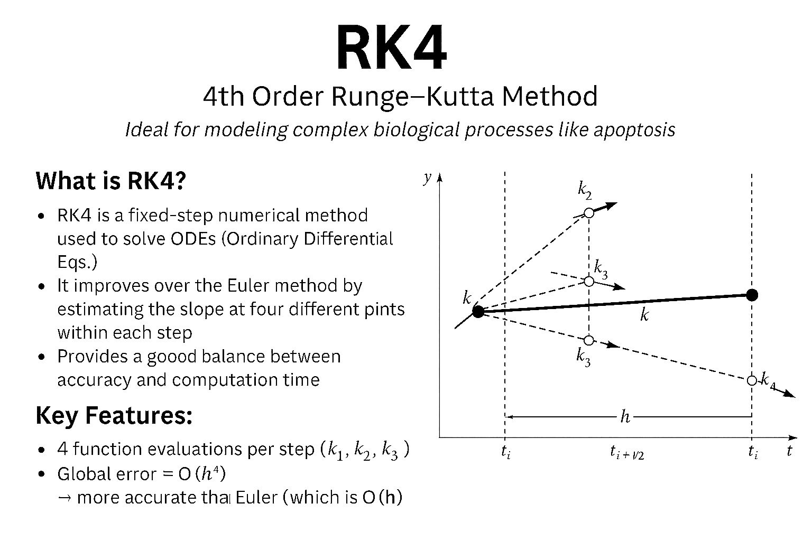
RK4
4TH ORDER RUNGE-KUTTA METHOD
What is RK4?
RK4: fixed-step method for solving ODEs
Ideal for modeling biological systems like apoptosis
More accurate than Euler → uses 4 slope estimates
Reliable for predicting system behavior over time
13

Slide 14
HOW RK4 WORKS?
RK4 estimates the solution using a weighted average of 4 slopes (k₁ to k₄):
k₁ → Slope at the beginning of the interval
k₂ → Slope at the midpoint
k₃ → Another midpoint slope
k₄ → Slope at the end of the interval
Final result is a weighted average of these slopes:
yₙ₊₁ = yₙ + (h/6)·(k₁ + 2k₂ + 2k₃ + k₄)
This approach captures the curvature of the solution more accurately
def rk4_step(f, t, y, h):
k1 = f(t, y)
k2 = f(t + h/2, y + h * k1 / 2)
k3 = f(t + h/2, y + h * k2 / 2)
k4 = f(t + h, y + h * k3)
return y + (h / 6) * (k1 + 2 * k2 + 2 * k3 + k4)
# Time integration loop
y = y0.copy()
for n, t in enumerate(times[::-1]):
y = rk4_step(dydt, t, y, h)
results[n + 1] = y
14

Slide 15
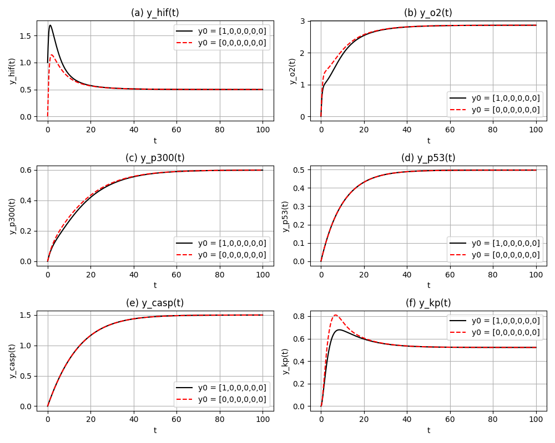
EFFECT OF INITIAL CONDITIONS
RK4 Results for Two Scenarios
Case A (y(0) = [1,0,0,0,0,0])
HIF increases rapidly, activating p53 and caspase cascades.
Oxygen, p300, and K⁺ exhibit anticipated dynamics.
Case B (y(0) = [0,0,0,0,0,0])
By changing the initial values the system still staple.
Visual:
Two overlaid time-course plots (t ∈ [0,100]) for each variable:
Solid lines: Case A
Dashed lines: Case B
15

Slide 16
LIMITATIONS OF RK4
Limitations:
Higher per-step cost with four function evaluations, 3–4 times more than Euler
Requires manual tuning of step size; larger values may miss fast transients..
Less adaptive, lacking automatic error control like RKF45 for optimal precision.
16

Slide 17
PINNS OVERVIEW
Environment & Data
Framework: PyTorch
Training Domain: t ∈ [0, 100], 200 collocation points
Initial Condition: y(0) = [1, 0, 0, 0, 0, 0]
Baseline Solver for Comparison: SciPy’s solve_ivp (RKF45)
17

Slide 18
NETWORK ARCHITECTURE & TRAINING LOOP
model = PINN().to(device)
optimizer = torch.optim.Adam(model.parameters(), lr=1e-3)
mse_loss = nn.MSELoss()
# Training data
t_train = torch.linspace(0, 100, 200).view(-1, 1).requires_grad_(True).to(device)
t0 = torch.tensor([[0.]], requires_grad=True, device=device)
y0 = torch.tensor([[1., 0., 0., 0., 0., 0.]], device=device)
# Derivative helper
def gradients(y, x):
return torch.autograd.grad(y, x, grad_outputs=torch.ones_like(y), create_graph=True)[0]
print("Starting training...")
for epoch in range(5000):
optimizer.zero_grad()
# Forward pass
y_pred = model(t_train)
y_hif, y_o2, y_p300, y_p53, y_casp, y_kp = [y_pred[:, i:i+1] for i in range(6)]
# Losses
loss_f = (f1**2 + f2**2 + f3**2 + f4**2 + f5**2 + f6**2).mean()
y0_pred = model(t0)
loss_ic = mse_loss(y0_pred, y0)
loss = loss_f + loss_ic
# Backward pass
loss.backward()
optimizer.step()
if epoch % 500 == 0:
print(f"Epoch {epoch}, Loss: {loss.item():.5f}")
PINN Design & Optimization
Model: 3‑layer MLP (1→64→64→6) with tanh activations
Inputs/Outputs:
Input: scalar t
Output: [ŷ_hif, ŷ_o2, ŷ_p300, ŷ_p53, ŷ_casp, ŷ_kp]
Loss:
Physics Loss: MSE of ODE residuals f₁…f₆
IC Loss: MSE at t=0
Total = Physics + IC
Optimizer:
Adam (lr=1e‑3), 5 000 epochs
Print loss every 500 steps
18

Slide 19
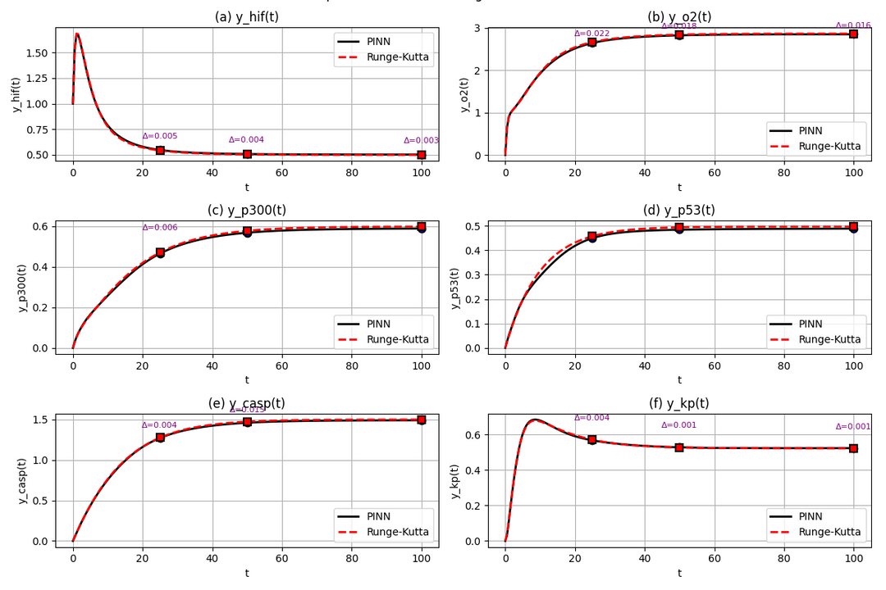
PINN VS RKF45 – TIME COURSES
Solution Trajectories
Plot Details:
Black solid: PINN predictions
Red dashed: RK45 reference
Markers at t=25, 50, 100 with Δ‑value annotations
Observation: PINN closely tracks RK45 across all six variables
19

Slide 20
ANALYSIS
All Calculations at T = 100
Method | Yhif | Yo2 | Yp300 | Yp53 | Ycasp | Ykp
Runge-Kutta-Fehlberg (RKF45) | 0.4990 | 2.8646 | 0.5977 | 0.4970 | 1.4967 | 0.5219
Fourth order Runge-Kutta (RK4) | 0.4990 | 2.8646 | 0.5977 | 0.4970 | 1.4967 | 0.5219
Error | 0.144×10-4 % | 0.470×10-5 % | 0.488×10-4 % | 0.579×10-4 % | 0.903×10-5 % | 0.477×10-4 %
Explicit Euler | 0.4990 | 2.8646 | 0.5977 | 0.4970 | 1.4967 | 0.5219
Error | 0.705×10-4 % | 0.463×10-4 % | 0.192×10-3 % | 0.410×10-4 % | 0.869×10-4 % | 0.216×10-4 %
Physics-Informed Neural Network (PINN) | 0.5027 | 2.8491 | 0.5871 | 0.4887 | 1.4878 | 0.5228
Error | 0.7435% | 0.5417% | 1.7866% | 1.6647% | 0.5925% | 0.1722%
20

Slide 21
RESULT
Method | Execution Time | Max Percentage Error | Min Percentage Error
Runge-Kutta-Fehlberg (RKF45) | 0.042 sec | ---- | ----
fourth order Runge-Kutta (RK4) | 0.939 sec | 0.579×10-4 % | 0.470×10-5 %
Explicit Euler | 0.189 sec | 0.192×10-3 % | 0.216×10-4 %
Physics-Informed Neural Network (PINN) | 0.01092 sec | 1.7866% | 0.1722%
21

Slide 22
FUTURE WORK
Next Steps
Refining parameters using experimental data
Developing hybrid RKF45–PINN solvers
Validating results in cell cultures
Extending the work to spatial (PDE) models
22

Slide 23
CONCLUSION
Developed an ordinary differential equation (ODE) model to investigate hypoxia-induced apoptosis, focusing on the dynamics of HIF, O₂, p300, p53, caspases, and K⁺.
Through comparative tests, we assessed:
Euler's method for its straightforwardness
RK4 for its effective balance of cost and accuracy
RKF45 for its adaptive precision
Utilizing Physics-Informed Neural Networks (PINNs) yielded smooth solutions that closely aligned with the outcomes derived from RKF45.
This integrated strategy—combining classical solvers with machine learning—presents a flexible framework for applications in biomedical engineering.
23

Slide 24
REFERENCE
[1] L. Euler, Institutionum calculi integralis, 1768–1770. Introduced the explicit Euler method, the first-order ODE solver.
[2] C. Runge, “ ¨Uber die numerische Aufl¨osung von Differentialgleichun- gen,” Mathematische Annalen, vol. 46, pp. 167–178, 1895. M. Kutta, “Beitrag zur n¨aherungsweisen Integration totaler Differentialgleichun- gen,” Zeitschrift f¨ur Mathematik und Physik, vol. 46, pp. 435–453, 1901. Together, they developed the RK family, including the 4th-order RK4 method.
[3] E. Fehlberg, “Low-order classical Runge-Kutta formulas with step- size control and their application to some heat transfer problems,” NASA Technical Report R-315, 1969. This paper introduced the adaptive RKF45 solver with embedded error control.
[4] M. Raissi, P. Perdikaris, and G. E. Karniadakis, “Physics-Informed Neural Networks: A Deep Learning Framework for Solving Forward and Inverse Problems Involving Nonlinear Partial Differential Equations,” Journal of Computational Physics, vol. 378, pp. 686–707, 2019. Pro- posed PINNs—a modern ML-based solver that embeds physical laws into neural networks.
[5] W. E. Schiesser, Differential Equation Analysis in Biomedical Science and Engineering: Ordinary Differential Equation Applications with R. Wiley, 2014. Demonstrated biomedical modeling using ODEs and R, with case studies including apoptosis.
24

Slide 25
THANK YOU
25

